Slide 1
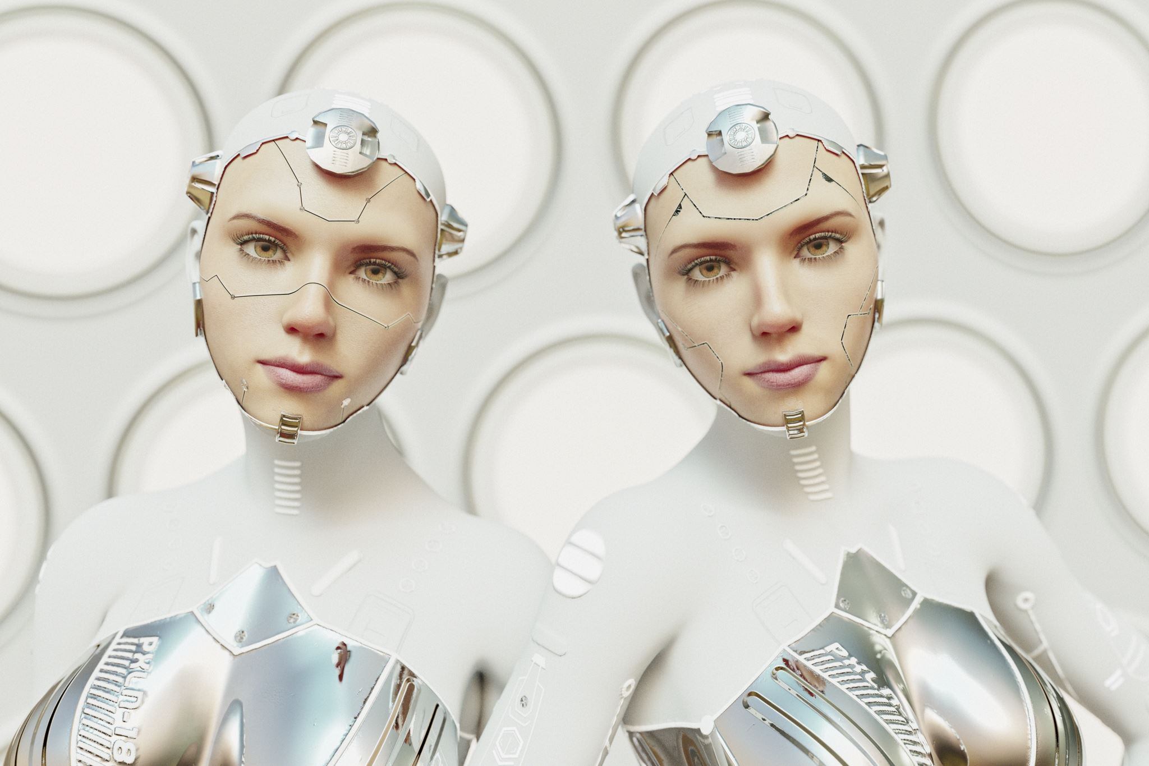
Face Reconition for Limited Resources Devices Computer Vision By Alvaro Cervan Canton, Lucerne University of Applied Sciences and Arts, 2025

Slide 2
What is Face Recognition?
Fundamental task in computer vision in which a model is capable to identify a face on an image and determine their identity by classification or comparison.
Diverse applications, such as: device unlock, surveillance, access control, social media tagging...
This project focuses on the face detection and comparison between images for security and log-in functions.
Deep learning, especially CNNs, have boosted face recognition accuracy by learning robust facial features. These models outperform older methods, even under poor lighting or angle variations.

Slide 3
Project Objective and Motivation
Objective: To evaluate and compare various deep learning models for face classification and validation.
Dataset: Curated dataset of 18 faces, about 100 images each.
Goals: Understand performance, analyze generalization/overfitting, develop a reproducible evaluation framework.
Why it Matters: Insights into transfer learning for smaller datasets, foundational work for resource-constrained deployments.
Question: What are the options for less powerful devices like smartphones or laptops to use non-proprietary models and implementations.
Notes:
example

Slide 4
The Datasets
Original Dataset
The dataset contains 17 celebrities (100 images each) from kaggle + the student images from a face scan video (300 images), totalling around 2000 images.
All images were pre-processed by using MTCNN for face detection, resizing, cropping (128x128) and normalization.
Augmentation
Images augmented in 3 different ways: Horizontal flip, slight rotation and color jitter
This created for each original images, 3 extra augmented, totalling 2000 x 4 = 8000 images
To avoid a previous data leakage, the Split is done 70% - 15% - 15% in a non-random way, making deterministic and checking that all 4 images (original + 3 augmented) were in a single Split.

Slide 5
Models
Classical Approaches: PCA, LBP
Transfer Learning (CNN Baselines): VGG16 (fine-tuned), MobileNetV2
Embedding-Based (State-of-the-Art): FaceNet, ArcFace (with KNN classifier)

Slide 6
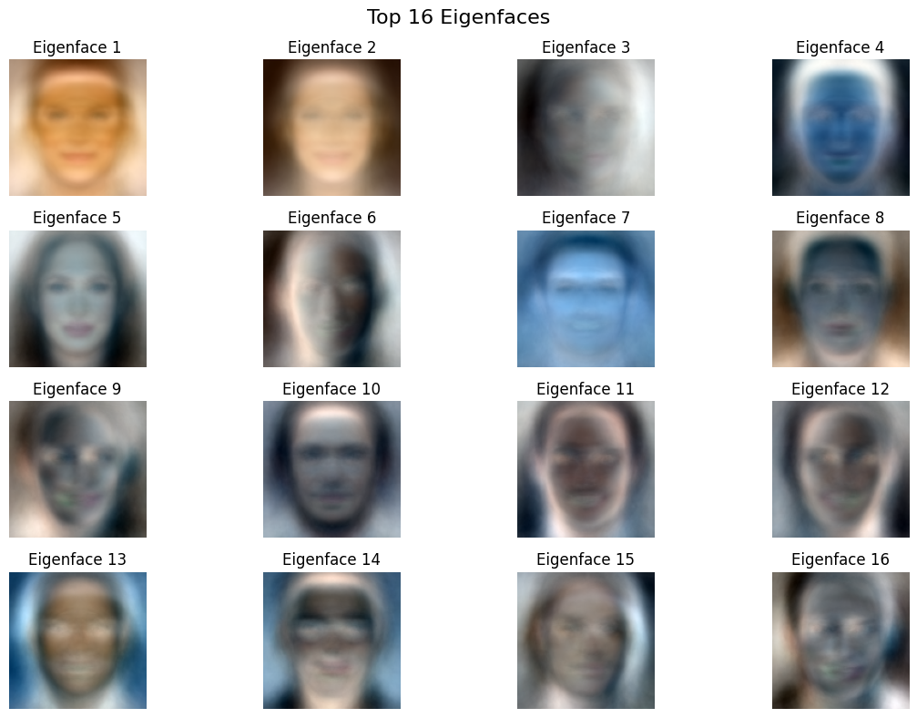
Models: Classical Approaches - PCA
PCA (Principal Component Analysis) reduces high-dimensional image data into the most important features (called principal components).
KNN (K-Nearest Neighbors) classifies a face by comparing it to the most similar examples in the training set.
Results:
Original Dataset:
Accuracy: 21.15% — struggled with class separation.
With Augmentation:
Accuracy: 44.34% — improved due to more diverse training samples.
Conclusion: PCA + KNN is simple and fast, but lacks the robustness of modern deep learning methods. Augmentation helps, but performance is still limited.

Slide 7
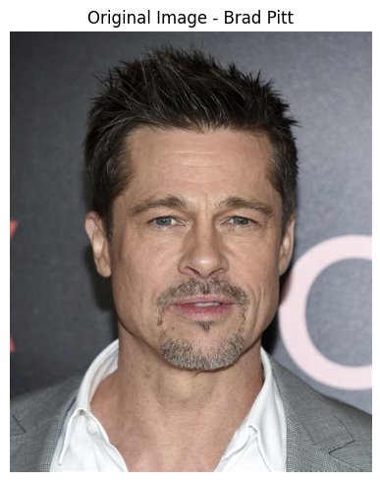

Models: Classical Approaches - LBP
LBP (Local Binary Patterns) captures texture features from grayscale images at multiple scales.
SVM (Support Vector Machine) is trained on these features to classify identities.
Results:
Original Dataset:
Accuracy: 30.51%
With Augmentation:
Accuracy: 35.65%
Conclusion: LBP + SVM performs better than PCA in capturing local patterns but still underperforms in diverse conditions. Data augmentation gives a slight boost.

Slide 8
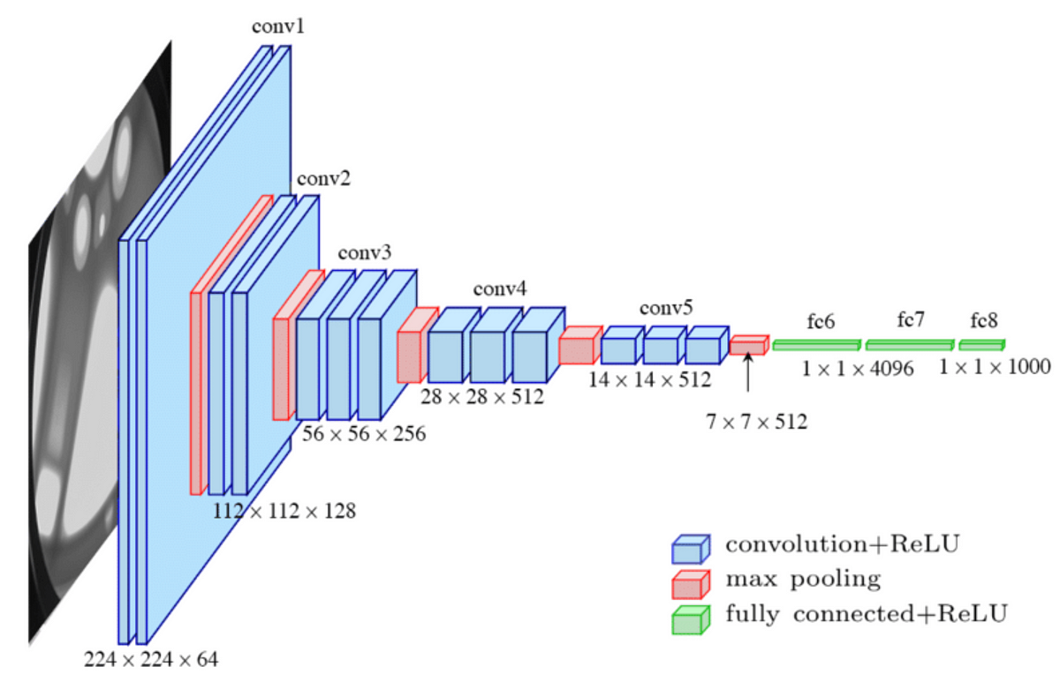
Models: Transfer Learning – VGG16 Base
Loads VGG16 pre-trained on ImageNet, cuts off the classifier (include_top=False).
Freezes the entire convolutional base — i.e., it won’t update weights but provides fast training.
Adds a simple custom head:
GlobalAveragePooling2D: collapses spatial dimensions → reduces overfitting, fewer params.
Dense(256, relu) and Dropout(0.5): classic dense head.
Final classification with Dense(num_classes, softmax).
Results (Accuracy):
Original Dataset: 43.8%
Augmented: 66.84%
Conclusion: Outperforms classical PCA and LBP methods, leverages deep, hierarchical features and is well-suited for complex visual patterns in faces.

Slide 9
Models: Transfer Learning – Custom VGG16 (finetuned)
First 10 layers frozen (general features), others fine-tuned for face-specific patterns
Batch Normalization: Added after pooling & Dense layers — stabilizes training, improves convergence.
Dropout (0.4 × 2) Reduces overfitting, complements BatchNorm for robust generalization.
Callbacks: Early Stopping + Reduce Learning Rate on Plateau dynamically adjust training to preserve best weights.
Results (Accuracy):
Original Dataset: 82.17%
Augmented: 93.81%
Conclusion: Finetuned model clearly outperforms the base model, shows significant improvement by the augmented dataset but has slower training. A scalable and accurate solution for face recognition in real-world scenarios.

Slide 10
Models: Transfer Learning – MobileNetV2
Lightweight, efficient CNN optimized for speed and performance, ideal for small devices
Features:
Partial Unfreezing: First 20 layers frozen → preserves low-level features
Fine-tuning deeper layers: Adapts MobileNetV2 to facial identity recognition
Batch Normalization: Added after pooling and dense layer
Dropout (0.3 × 2): Regularizes and prevents overfitting
Mixed Precision Enabled: Faster training, reduced memory usage
Callbacks: Early Stopping and RLRPlateau.
Results (Accuracy):
Original Dataset: 67.37%
Augmented: 84.29%
Conclusion: Fine-tuned MobileNetV2 balances performance and efficiency well fitted for mobile face recognition applications. Less performant tan VGG16 but faster to train.
Notes:
It has many more layers tan VGG16

Slide 11
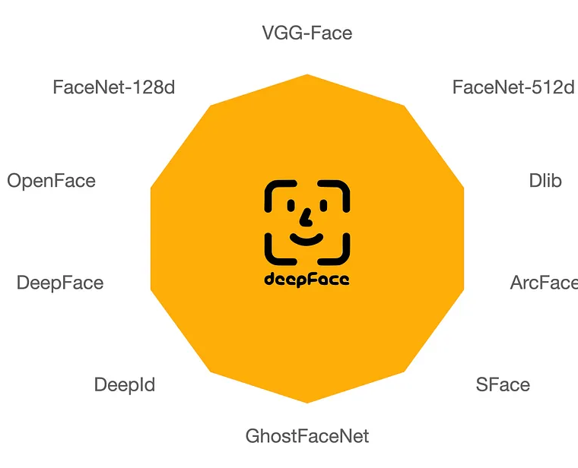
Models: Embedding Based – FaceNet (Google)
Uses DeepFace library to implement and to extract high-quality FaceNet embeddings.
Face Embeddings: Pre-trained FaceNet generates identity-aware descriptors
learns a 128D vector for each face → optimized for identity separation
Simple KNN classifier (k=1) used on embeddings for final recognition
Embedding-to-embedding comparison (Euclidean distance)
No retraining needed: Embeddings computed once → fast and memory-efficient
Results: Original dataset 88.18%

Slide 12
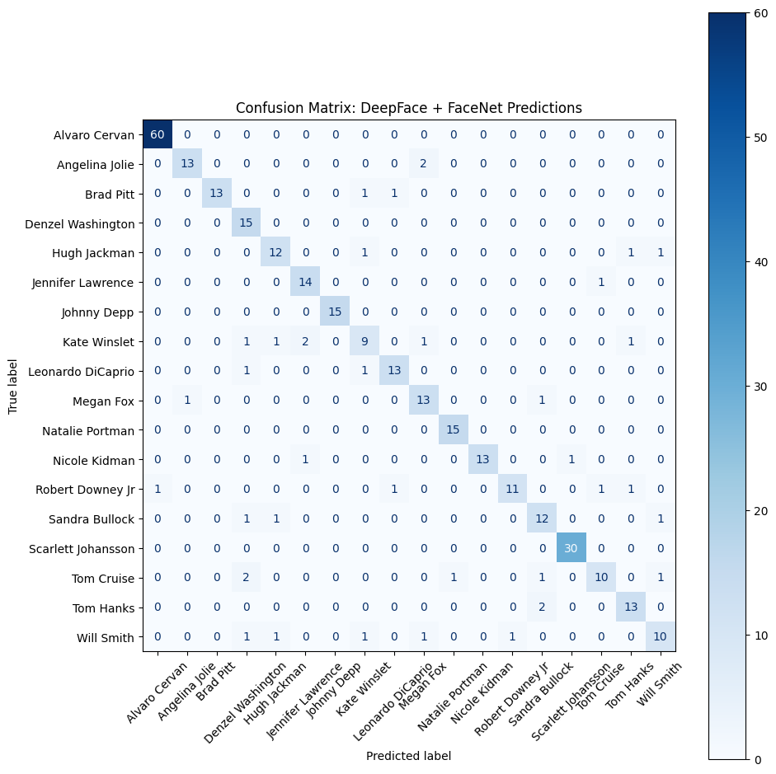
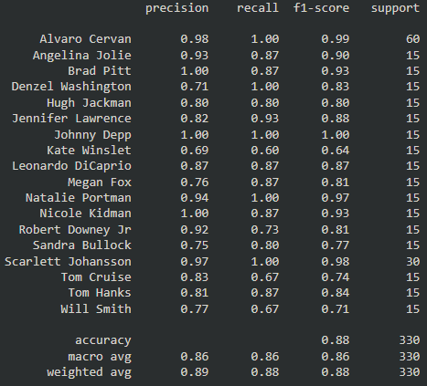
FaceNet Confusion Matrix
Noticeable F1 scores for Johnny Deep, Alvaro or Scarlet Johansson for a near 100% score.
Worst performers were Kate Winslet and Wills Smith
Facenet Evaluation scores per class (actor name)

Slide 13
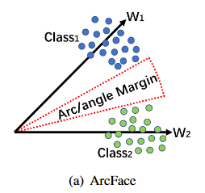
Models: Embedding Based – ArcFace
Uses ArcFace (buffalo_l) from InsightFace with RetinaFace detector. Embeddings are 512-dimensional and extracted per aligned face.
Images are preprocessed (RGB, resized to 112×112).Embeddings are generated using the native ArcFace model.
Classification is done using 1-NN with Euclidean distance.No model training is needed — it's a retrieval-based approach.
Embeddings from training + validation form the reference set.Test samples are matched against this using direct comparison.
If no face is detected, a zero-vector is assigned. Ensures robustness and avoids pipeline failure.
Results: Original dataset 91.81%

Slide 14
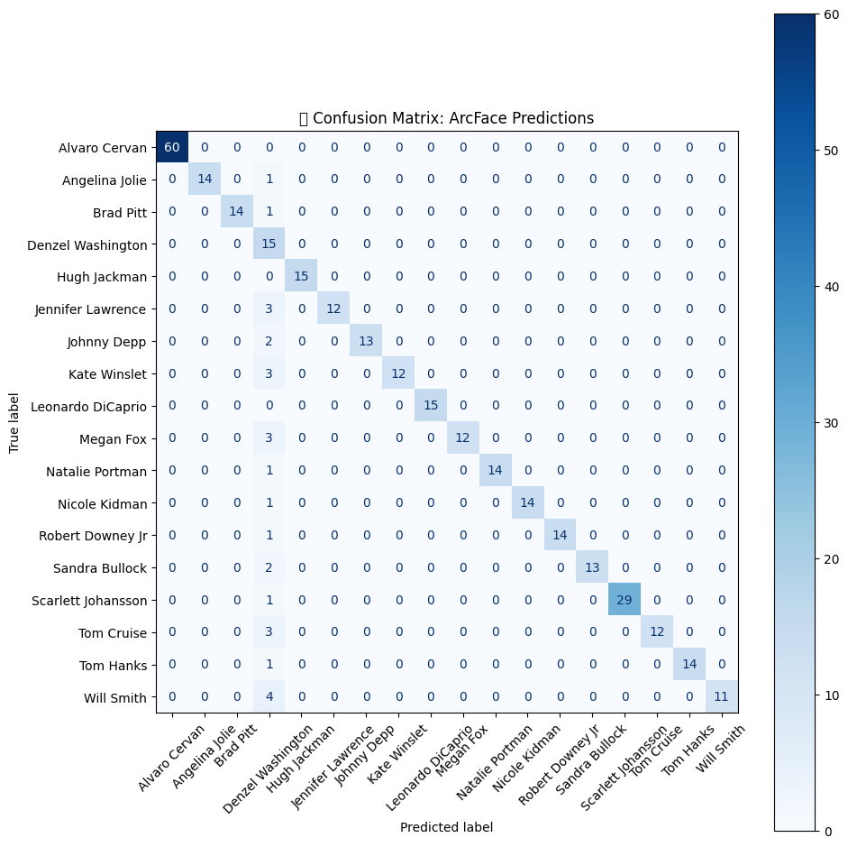
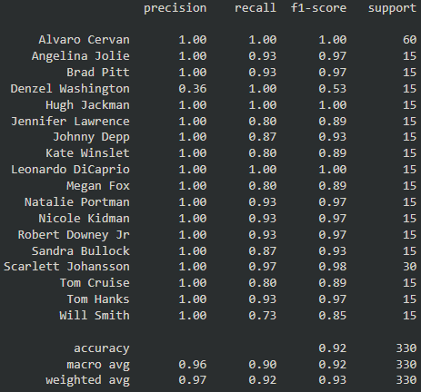
ArcFace Confusion Matrix
Precision noticeably better compared to FaceNet, outlier Denzel Washington.
Several identities achieve perfect precision and recall
Fast, accurate, and training-free approach
ArcFace Evaluation scores per class (actor name)

Slide 15
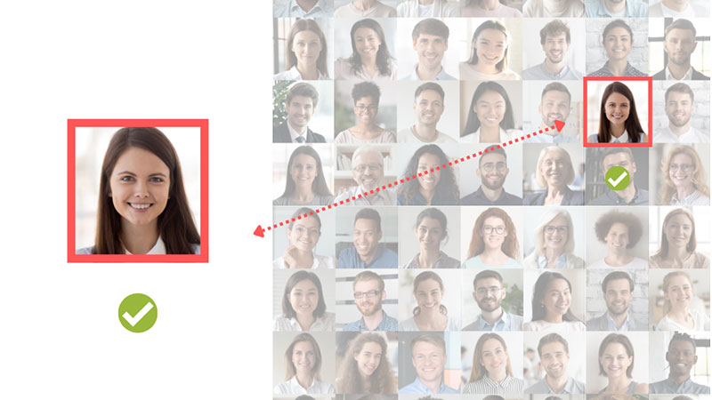
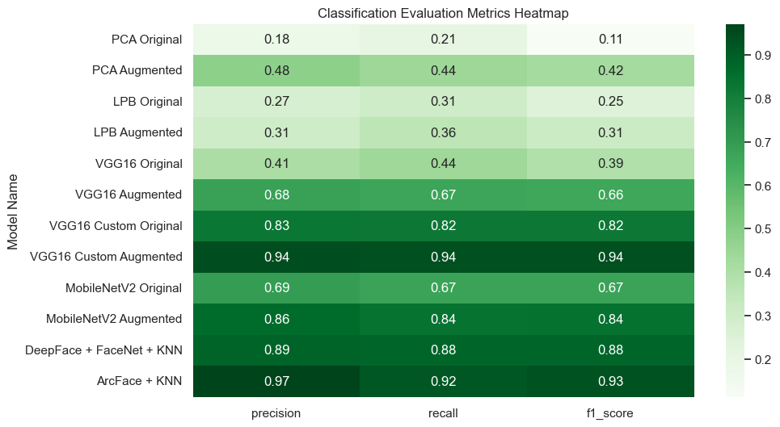
Evaluation - Classification
Images on the test set are assigned a class that can be correct or incorrect.
Useful to decide if an image (user login) matches any of the registered identities. The user must be on the model when trained.
Evaluation metrics are:
Accuracy: % of correct predictions.
Precision: % of predicted positives that are correct.
Recall: % of actual positives correctly predicted.
F1-Score: Balance between precision and recall.

Slide 16
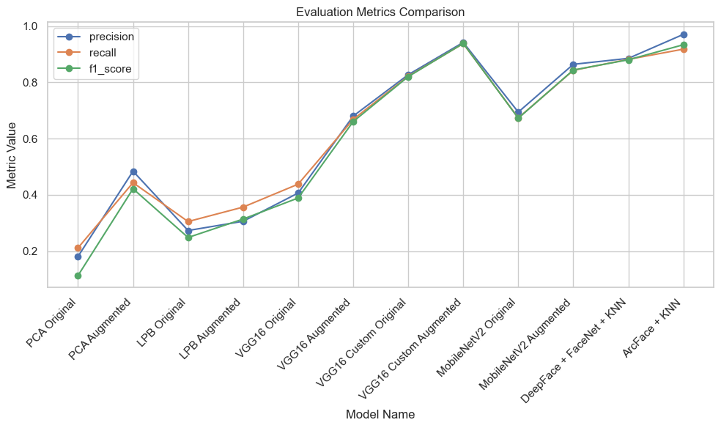
Evaluation - Classification - Comparison
Best models: VGG16 Custom trained on Augmented dataset and ArcFace, followed by DeepFace and MobileNetV2 trained on Augmented.
Worst performers: the Classical Approaches: PCA, LBP
Best models achieve F1_scores above 0.88, indicating strong and consistent prediction quality
CNN models outperform Classical ones even after augmentation, highlighting their limitations.

Slide 17
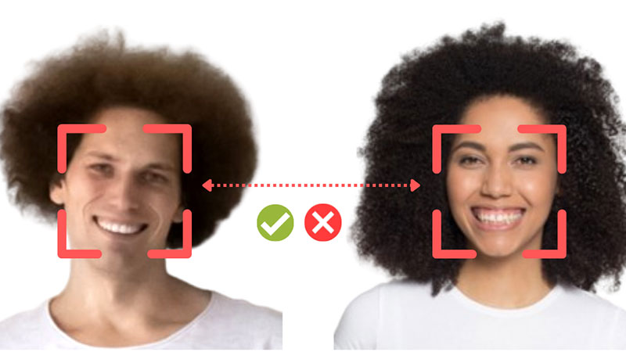
Evaluation – Validation 1:1
Measure whether two face images belong to the same person, regardless of their class label.
Used for open-set matching (compare user of the device with their identity on database)
Each image is passed through an embedding model -> numerical descriptor.
Compute pairwise distances (KNN)
Label each pair as Match or non-Match
The results are compared to their correct labels and claculate the metrics:
AUC (Area Under Curve): overall ranking performance.
EER (Equal Error Rate): the point where false acceptance = false rejection.

Slide 18
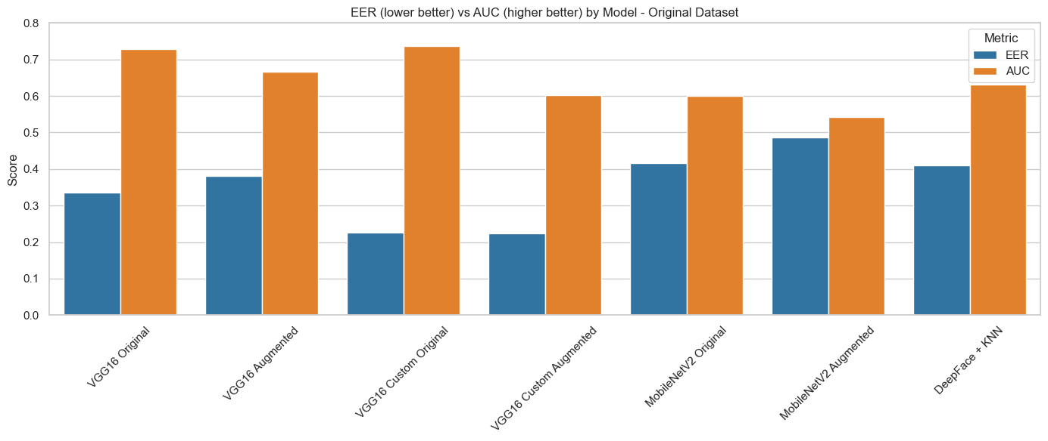
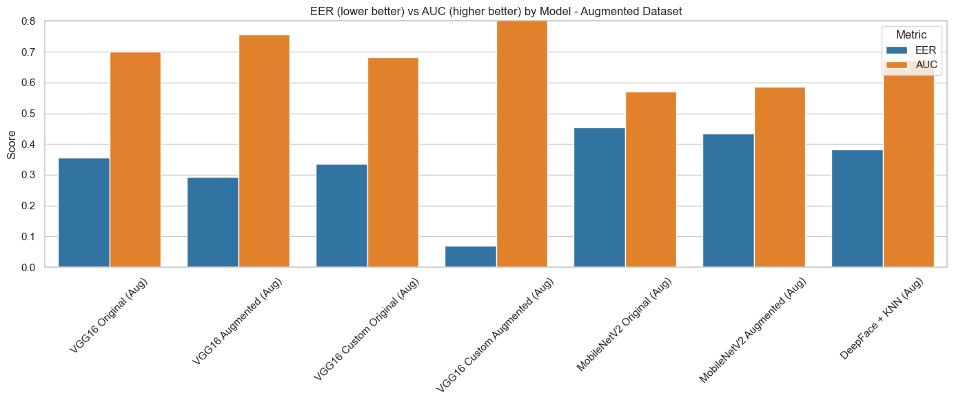
Evaluation – Validation 1:1 – Comparison
Custom VGG16 with augmentation produces the most reliable embeddings for identity verification.
Data augmentation significantly boosts verification accuracy when also used during training.
Fine-tuning improves embedding quality, especially for CNN-based models like VGG16.
MobileNetV2 and DeepFace models show limited generalization, underperforming across test sets.
Verification accuracy depends heavily on consistency between training and test distributions. (Real vs Verified face)
ArcFace failed to generate valid embeddings in this test due to dependency issues (excluded from conclusions).

Slide 19
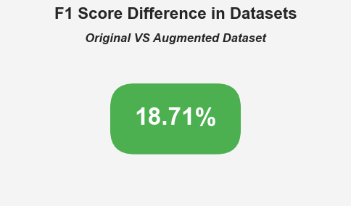
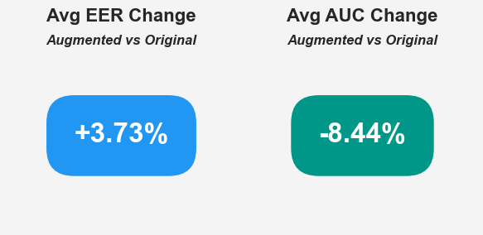
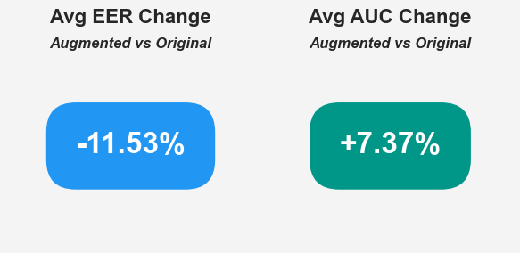
Does Data Augmentation matter?
Classification
Augmentation increases F1-score in classification by almost 19%.
In validation, depends wether the models were trained with original data (worse results) or also with augmented data (noticeable improvement)
Augmentation is critical for improving classification accuracy across all architectures.
For validation, augmentation must be mirrored in both training and evaluation to be effective.
Best results come from combining augmentation and fine-tuning, as seen in VGG16 Custom Augmented.
Embedding-based pipelines are highly sensitive to image distribution — augmentation must be controlled and consistent.
Validation Original Data
Validation Augmented
EER (Lower is Better)
AUC (Higher is Better)

Slide 20
Conclusions
Custom fine-tuned CNNs, especially VGG16 and MobileNetV2, deliver the strongest performance across both classification and verification tasks when trained on augmented data.
Embedding-based pipelines (ArcFace, FaceNet + KNN) are also highly effective, particularly in classification — but rely on clean, consistent input data and may struggle with verification if embeddings are misaligned.
Traditional methods (PCA, LBP) perform significantly worse, even with augmentation, and are not suitable for high-accuracy recognition.
Augmentation generally improves significantly a CNN model capabilities.

Slide 21

Conclusion 2
All top-performing models used in this project are publicly available and open source, making them accessible to developers and researchers without proprietary restrictions.
With proper input alignment, light preprocessing, and dataset-specific fine-tuning, these models can rival commercial solutions for many use cases — such as attendance tracking, personal security, or identity validation.
Final performance and deployment depend not just on model choice but also on pipeline design, preprocessing consistency, domain adaptation and specific target device.

Slide 22

Target to Devices (phone and laptop image)
With the best performing models, now its time to take into account other factors:
The easiest way to implement is DeepFace library with FaceNet.
Fastest training was from MobileNetV2.
Classic models - not considered for low performance
Best option: FaceNet implemente with DeepFace, provides one of the strongest performances with no training time. Embedding extraction is fast.
Devices could come with the model pre-downloaded, only calculation on device would be embedding extraction with possibility for image augmentation.
Viable option for Android pones, Linux distributions etc.

Slide 23

Demo – Log in with Face Recognition

Slide 24

Q&A
Thank you for listening
Any questions?

